Slide 1
 | Multicate | causalmeta | CATE | metacart | xmeta | personalized
Title | The package for estimating CATE across multiple studies, and for predicting the CATE in a target population of interest | The causalmeta package for Causally Interpretable Meta-Analysis provides robust and efficient methods for estimating causal effects in a target population using a multi-source dataset | The CATE package for High Deimensional Factor Analysis and Confounder Adjusted Multiple Testing in genome-wide data | Meta-CART integrates classification and regression trees (CART) into meta-analysis | A toolbox for meta-analysis. This package includes: a robust multivariate meta-analysis of continuous or binary outcomes | The personalized provides functions for fitting and validation of models for subgroup identification and personalized medicine / precision medicine under the general subgroup identification framework
Specifically for Clinical data? | O | O | X | O | O | O
Multiple Studies/sources? | O | O | X | O | O | X
Heterogeneity? | O | O | O | O | O | O
Individual traits (IPD)? | O | O | O | X | X | O
Estimation of CATE? | O | X | X | X | X | O
Prediction of CATE? | O | X | X | X | X | X
Description | Focusing on various combination of aggregation and estimation method for multiple studies and a target population, as well as visualization of covariate distributions across studies | Focusing on SATE (or PATE) using machine learning | Focusing on factor analysis | Focusing on indentifying the interaction effects between influential moderators in meta-analysis | Suggesting a new visualization plot (galaxy plot), but not specifically focusing on combining different RCTs | For subgroup identification under the general subgroup identification framework
Link | https://pubmed.ncbi.nlm.nih.gov/38273647/ | https://www.cambridge.org/core/journals/research-synthesis-methods/article/causalmetar-an-r-package-for-performing-causally-interpretable-metaanalyses | https://rdrr.io/cran/cate/ | https://cran.r-project.org/web/packages/metacart/index.html | https://pmc.ncbi.nlm.nih.gov/articles/PMC7438574/ | https://jaredhuling.org/personalized/

Slide 2
Two-Step Approach of multicate()
Training data
Multiple RCTs comparing treatment efficacy
Target population
Group of patients at baseline in a health care system
Data
Step 1
Estimate CATE in RCTs
Step 2
Predict CATE in target population
Approach

Slide 3
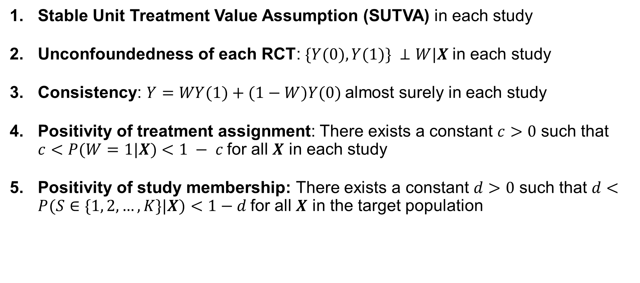
Assumptions
Stable Unit Treatment Value Assumption (SUTVA) in each study
Unconfoundedness of each RCT: $\{Y(0), Y(1)\} ⊥W|X$in each study
Consistency: $Y=WY(1)+(1−W)Y(0)$almost surely in each study
Positivity of treatment assignment: There exists a constant $c>0$ such that $c<P(W=1|X)<1 − c$for all $X$ in each study
Positivity of study membership: There exists a constant $d>0$ such that $d<P(S∈\{1, 2, …, K\}|X)<1−d$for all $X$ in the target population

Slide 4
Single-study methods
S-Learner
Causal Forest
Aggregation methods
No Pooling
Pooling with Trial Indicator
Ensemble Forest

